Slide 1
IAU 11th Communicating Astronomy with the Public CAP2024, Toulouse, 25 June 2024
How can we preserve the night sky?
Legal and policy considerations
Kai-Uwe Schrogl
President, International Institute of Space Law (IISL)
iisl.space

Slide 2
The night sky is dark and quiet…

Slide 3
https://upload.wikimedia.org/wikipedia/commons/4/4b/Batman_3.JPG

Slide 4
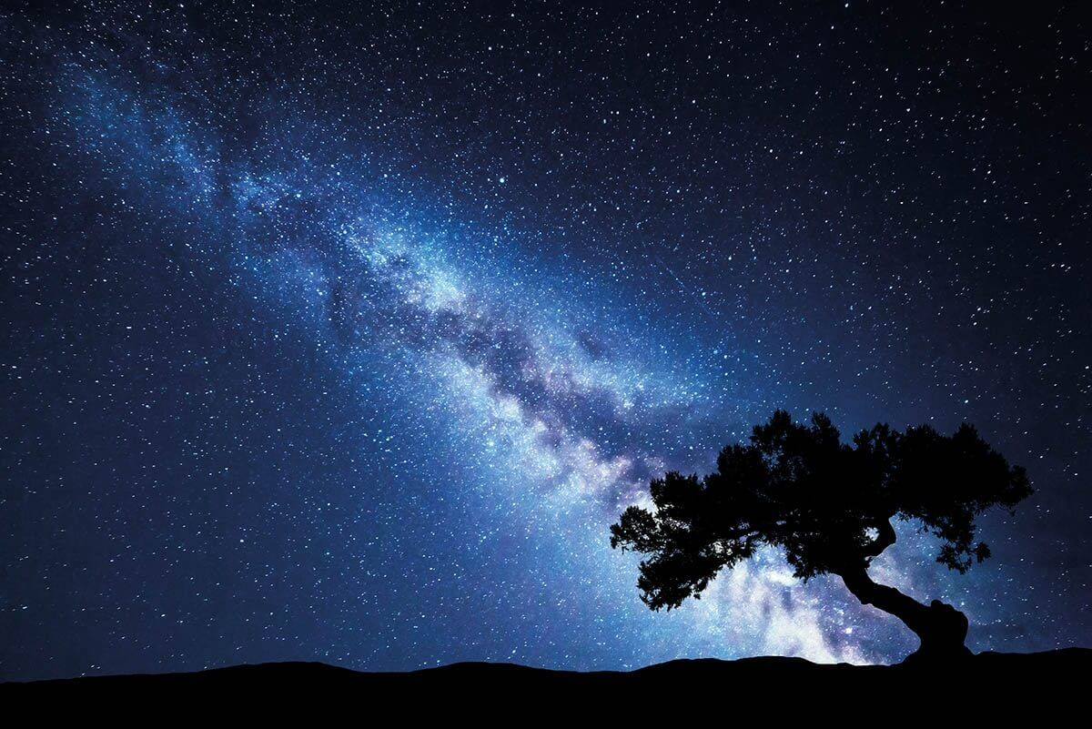
https://geographical.co.uk/science-environment/tips-and-tricks-for-astrophotography

Slide 5
But the reality is: light pollution…

Slide 6
…on Earth…

Slide 7
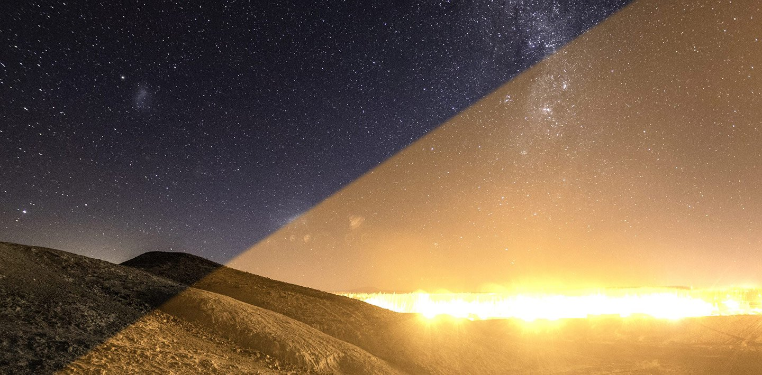
https://darksky.org/resources/what-is-light-pollution/

Slide 8
… and through space activities!

Slide 9
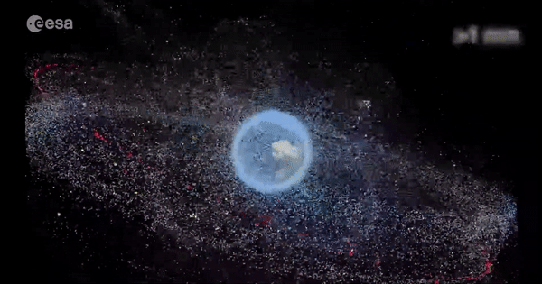
ESAhttps://www.esa.int/ESA_Multimedia/Images/2019/10/Distribution_of_space_debris_around_Earth/ESOC

Slide 10
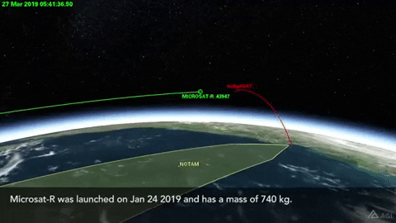
https://space.stackexchange.com/questions/35093/india-just-shot-down-a-satellite-from-the-ground-at-what-altitude-range-is-the

Slide 11
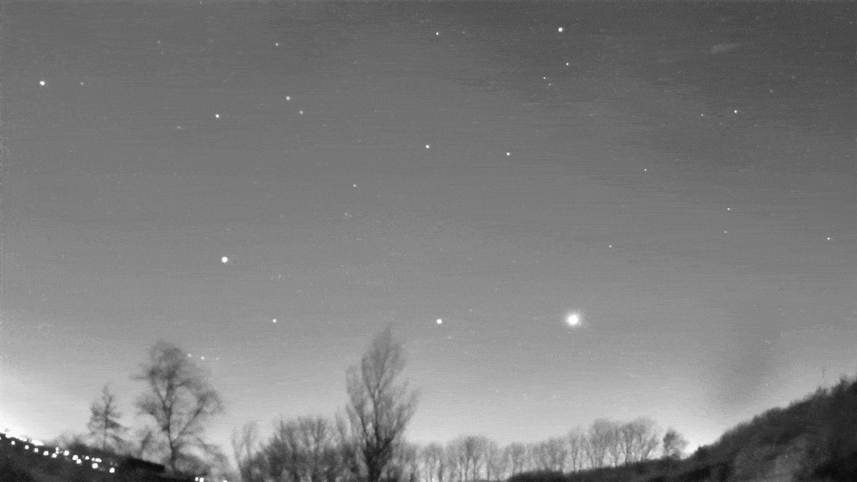
https://www.dias.ie/event/an-evening-of-meteors-massive-stars-and-citizen-science/

Slide 12
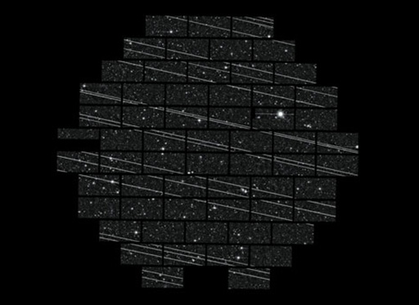
DELVE SURVEY, CTIO/AURA AND NS

Slide 13
…. and radio-frequency interference…

Slide 14
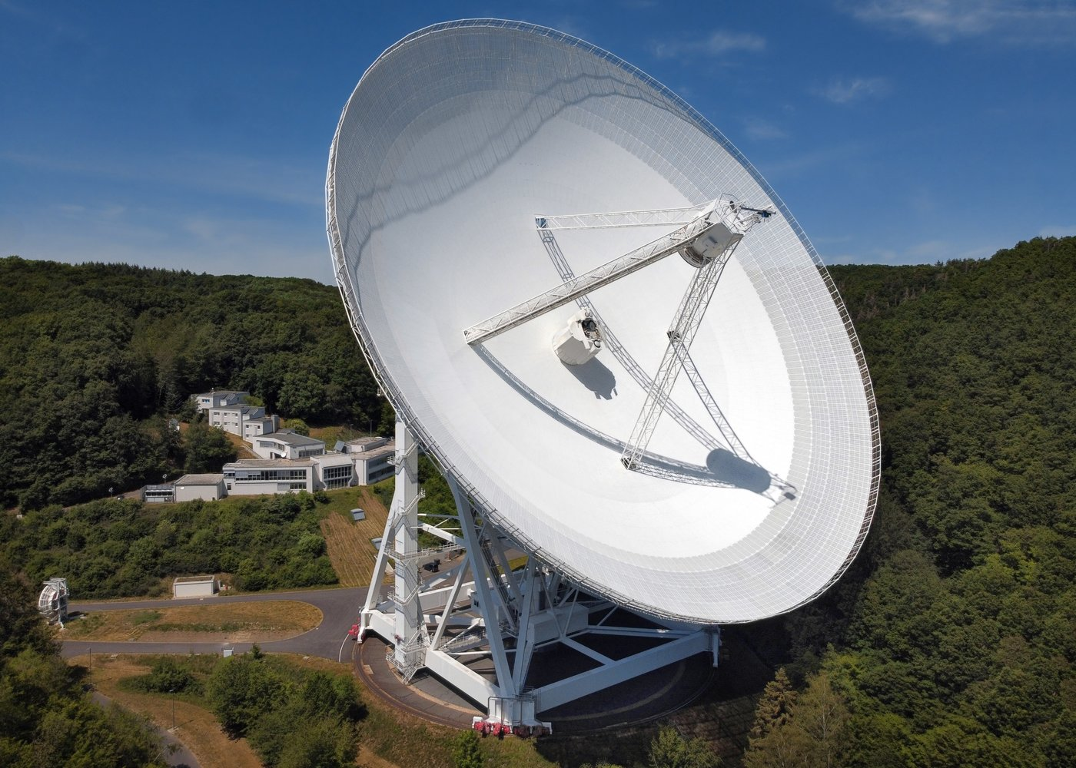
MPI Bonn

Slide 15
…and it is getting from bad to worse… …until we just escape…

Slide 16
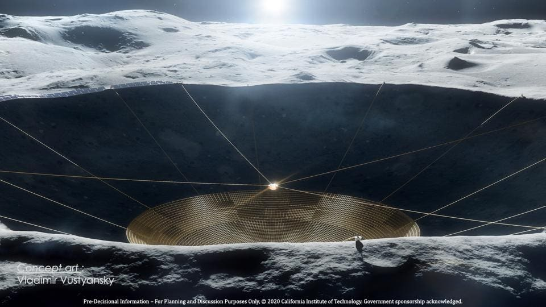

Slide 17
…but this cannot be the solution! We have to communicate the problem in a broader context with a policy as well as legal anchor: sustainability

Slide 18
Meeting the needs of the present without compromising the ability of future generations to meet their own needs.

Slide 19
Relevant key policy aspects of sustainability of space activities: * Generational principle. * Concept of the global commons. * Ethical, cultural, indigenous rights, animals/wildlife rights. * Encompasing public value, not only economic development.

Slide 20
What can space law contribute?

Slide 21
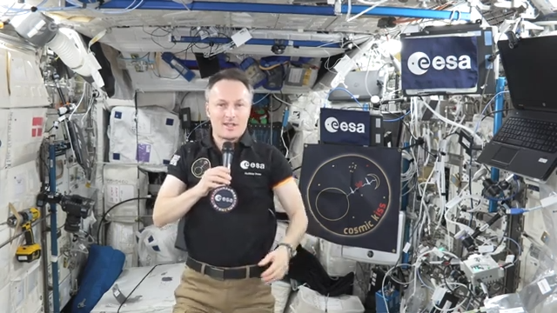
https://iisl.space/index.php/video-messages/ or https://www.youtube.com/watch?v=8hGMUE8UDiw&list=PLbyvawxScNbtUduOrYjd8U4KACfLR7_xZ&index=19

Slide 22
Key legal principles and provisions for protecting the night sky: * UN Outer Space Treaty with principles of due regard, avoidance of harmful interference and harmful contamination, as well as possibility to lead consultations. * Long-Term Sustainability negotiation process including space debris mitigation and Space Traffic Management. * ITU regulations on the avoidance of harmful radio-frequency interference.

Slide 23
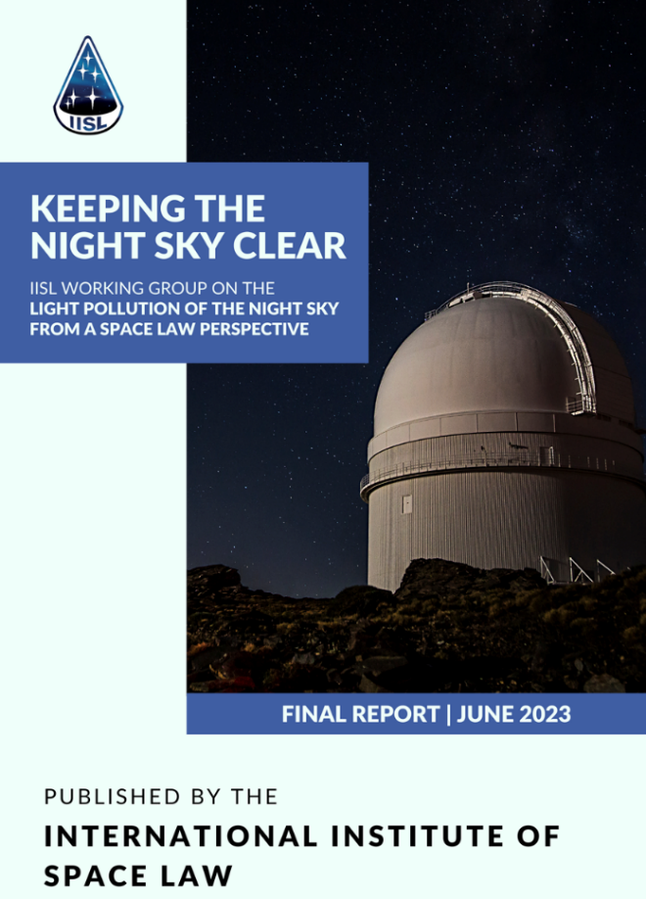
Publication of the IISL Report “Keeping the Night Sky Clear”
Report by an IISL study group in light pollution of the night sky from a space law perspective, initiated and coordinated by Rafael Moro Aguilar (published June 2023; submitted to UNCOPUOS-LSC in April 2024 as A/AC.105/C.2/2024/CRP.28).
IISL supports the IAU driven establishment of an agenda item on Dark and Quiet Skies, astronomy and large constellations: addressing emerging issues and challenges” in UNCOPUOS from 2025.
https://iisl.space/wp-content/uploads/2024/06/Report-of-IISL-Working-Group-on-the-Light-Pollution-of-the-Night-Sky-from-a-Space-Law-Perspective.pdf

Slide 24
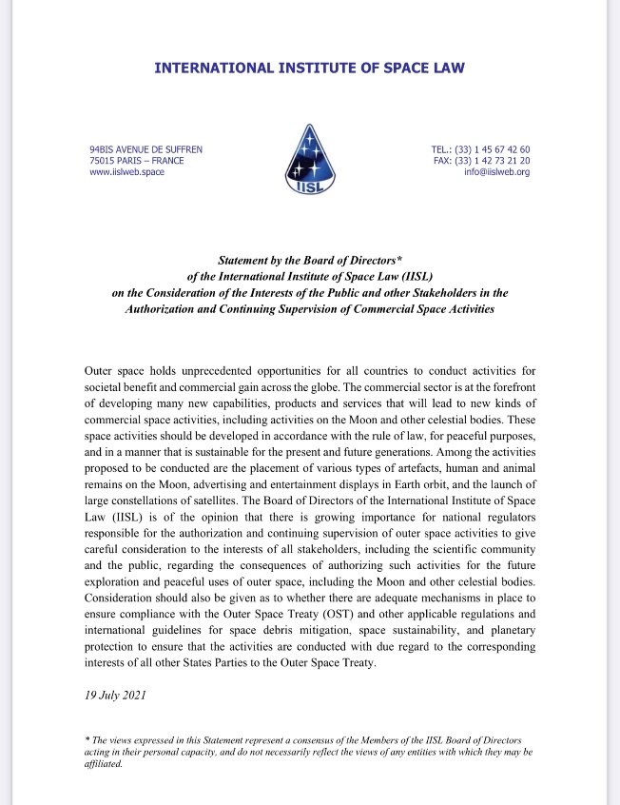
Governments have instruments to act: position paper by the IISL Board of Directors on authorization and continuous supervision of commercial space activities
(July 2021).

Slide 25
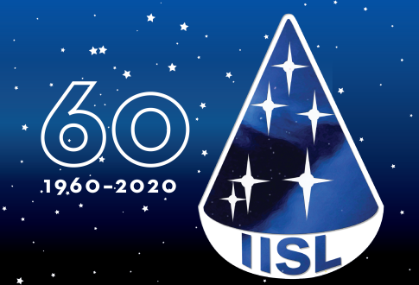
Maintaining the rule of law in outer space! www.iisl.space

Slide 26
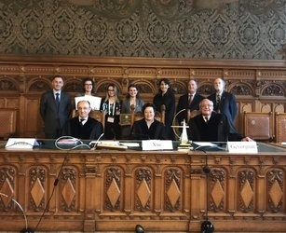
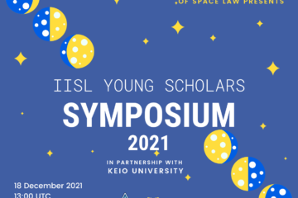
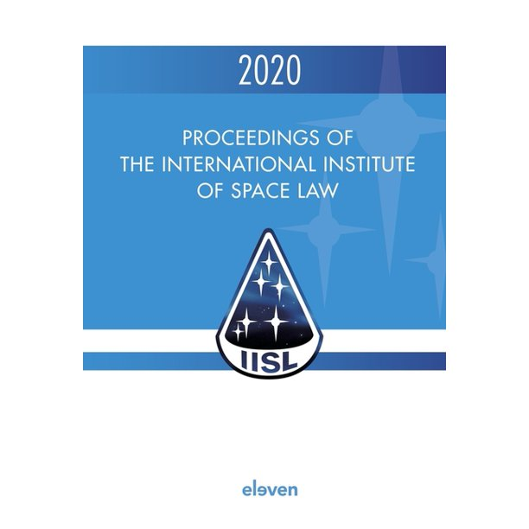
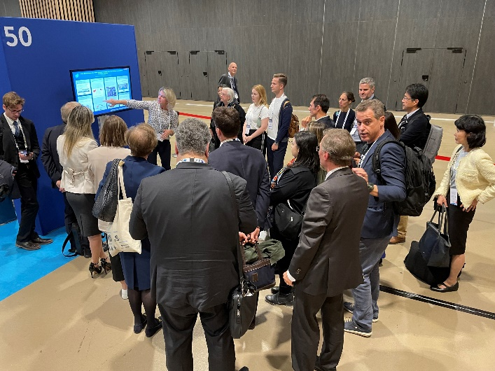
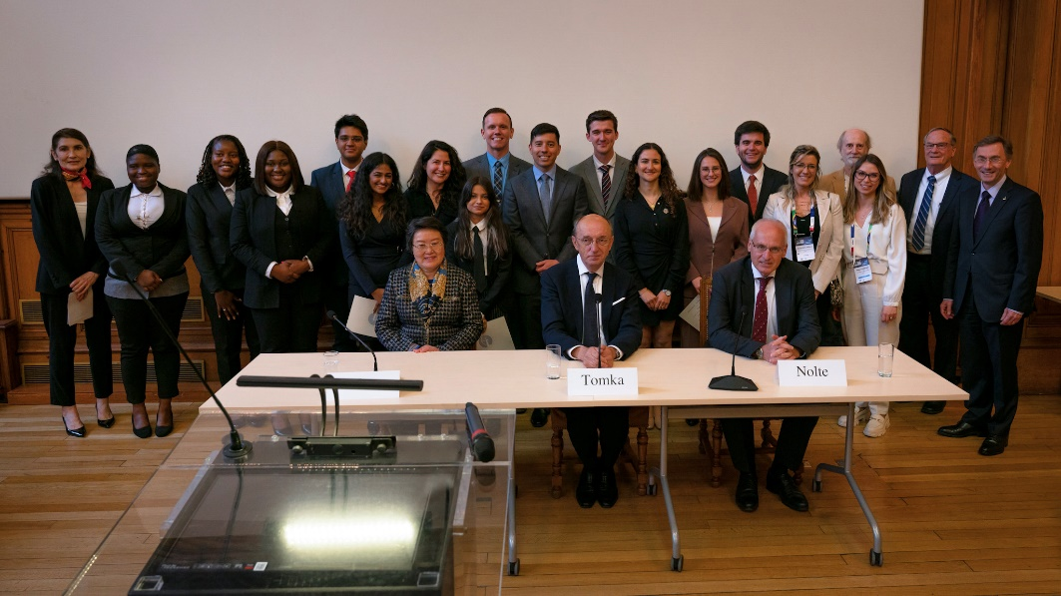
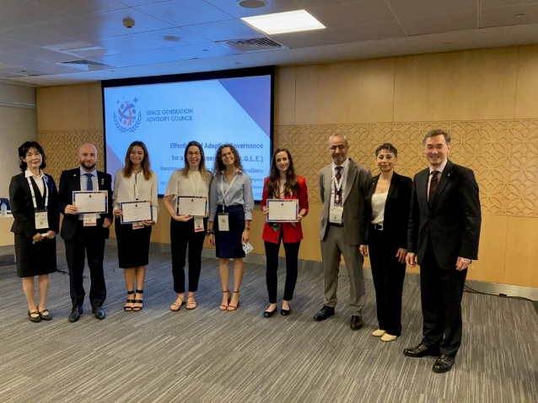
IISL
Created in 1960.
Members from almost 50 countries from all continents.
The main global platform of space lawyers in academic, government, industry and practice.
Continuously extending activities and formats (Colloquia, Symposia, Knowledge Constellation, Happy Hour and many more).
Continuously striving for relevance in space law making.
Continuously striving for engaging the youth (Young Scholars Sessions and Symposia, Moot Court Competition currently with a case involving light pollution).

Slide 27
IISL and IAU are united in tackling the problem!

Slide 28
How to act against light pollution created by space activities? A few recommendations for communication.

Slide 29
* Support and provide visibility to ongoing efforts of NGOs (as DarkSkyInternational). * Create awareness with politicians from the local to the national to the European level – they are more perceptive than you think. * Make it a case, with which politicians can shine… but not so much that they pollute the night sky…

Slide 30
* Make the societal impact clear, for culture and education, for animals and nature, for inspiration. * Remind of the economic impact on investments, public and private, in astronomy. * Be confident that useful regulations can be implemented.

Slide 31
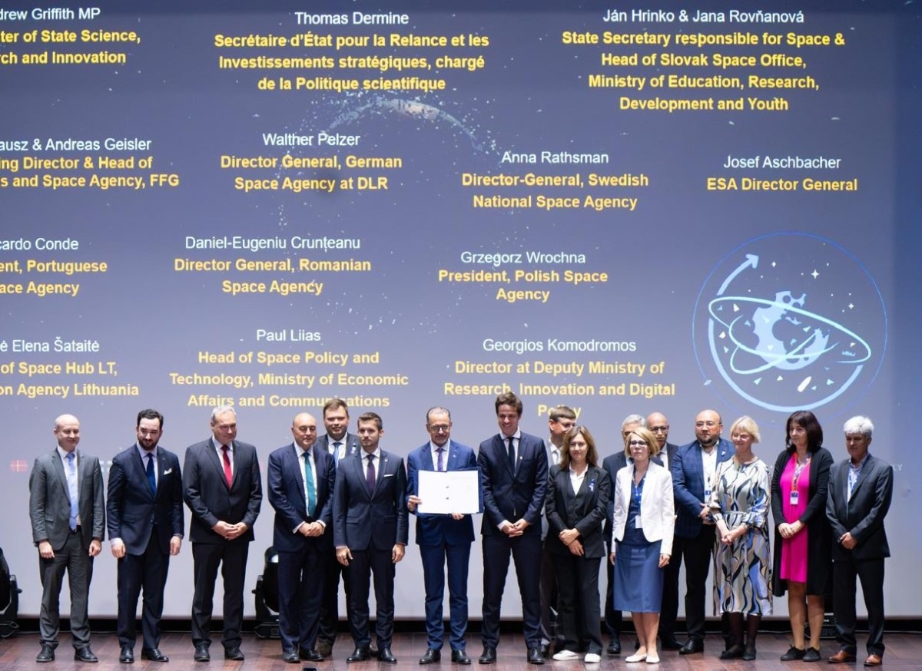
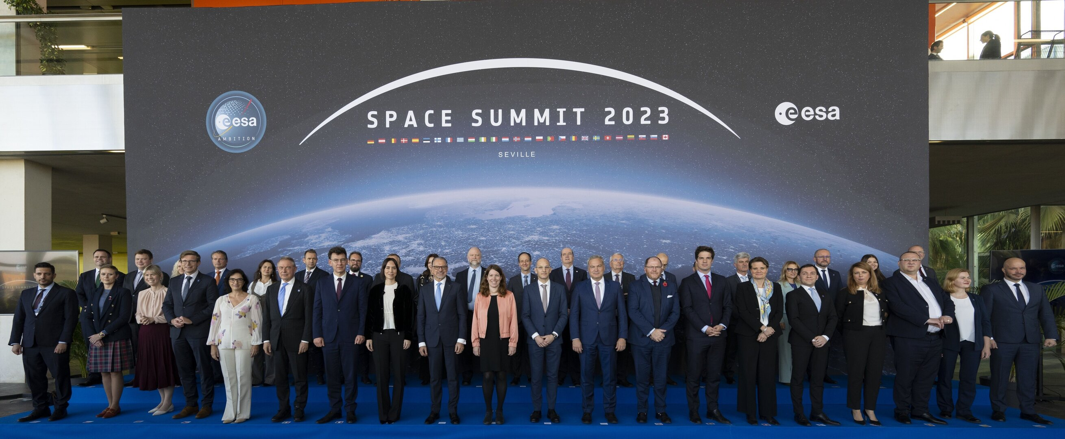
* In Europe, the Spanish EU Council Presidency puts the Night Sky on the agenda of the ESA-EU Space Summit in November 2023. * ESA introduced immediately after that the Night Sky in the Zero Debris Charter signed by more than 100 entities. * Lobbying has to be done to include it in the upcoming EU Space Legislation.

Slide 32
* Make it part of common international agendas like at the UN Summit for the Future. * Lobby the international forums as UNCOPUOS and ITU. * Create alliances as IAU ably does in UNCOPUOS with the establishment of an agenda item. * Promote multidisciplinary and inclusive study work like IISL’s report, presented to the Legal Subcommittee of UNCOPUOS.

Slide 33
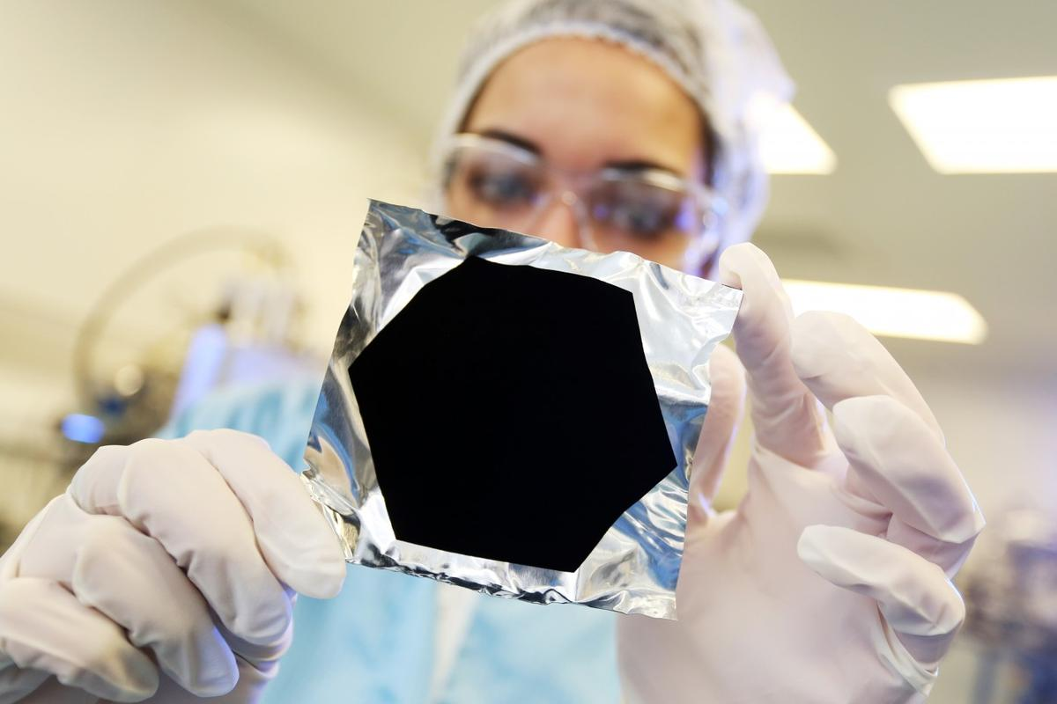
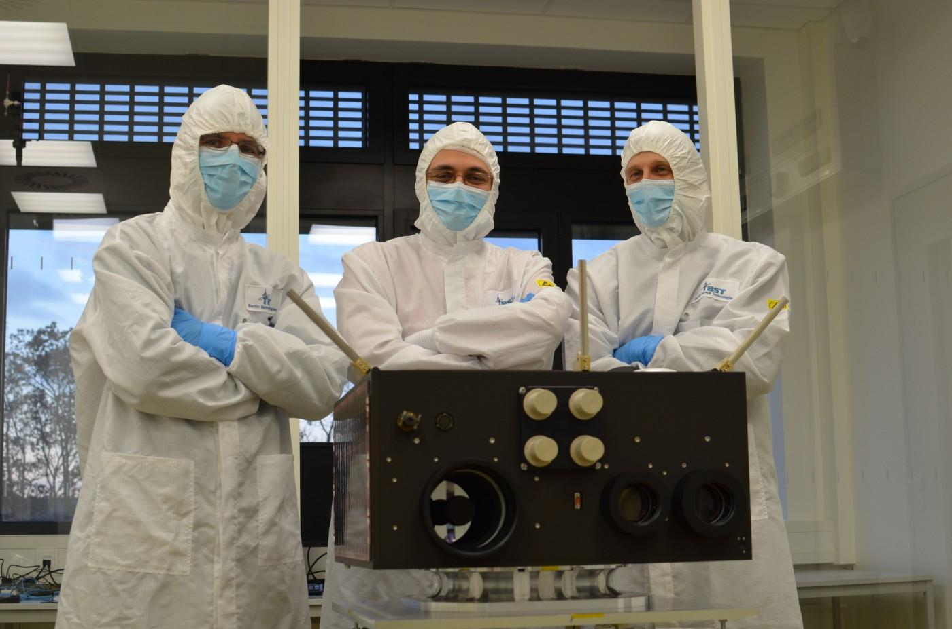
Self-regulation by industry? * Do not count it off. * In space it can work (Space Data Association for traffic management). * First efforts to better coat satellites by industry without prior governmental regulation – but this has to be translated into universally applicable norms to guarantee a level-playing field.
Surrey Nano Systems

Slide 34
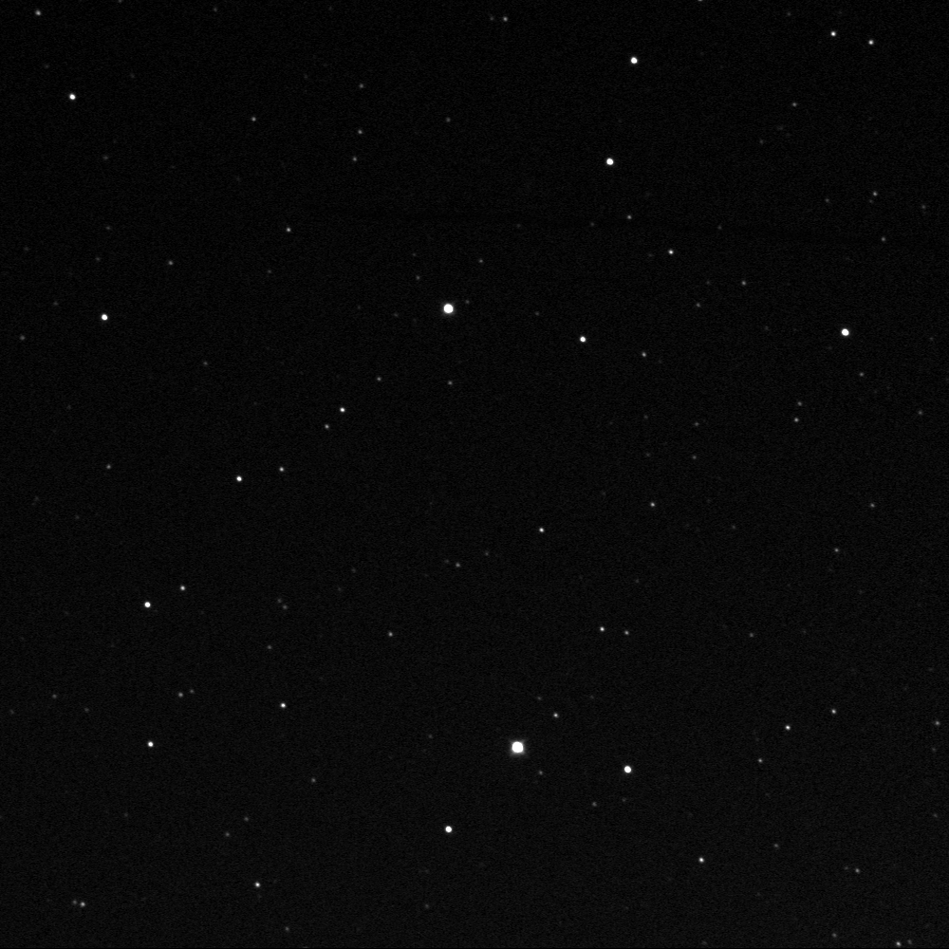
https://skyandtelescope.org/online-gallery/the-starlink-desaster/

Slide 35
Key messages for communication * Lobby politicians, agencies, the industry and diplomats. ** Use sustainability as the context for action. *** Request the creation of regulation and law, national and international. **** Promote to incentivise additional self-regulation.

Slide 36
Maintaining the rule of law in outer space! www.iisl.space

